Slide 1
Git-Connected

Slide 2
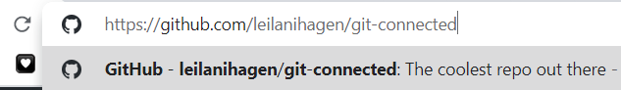
Get our slides!
1.
Go to https://github.com/leilanihagen/git-connected
(No GitHub account necessary)

Slide 3
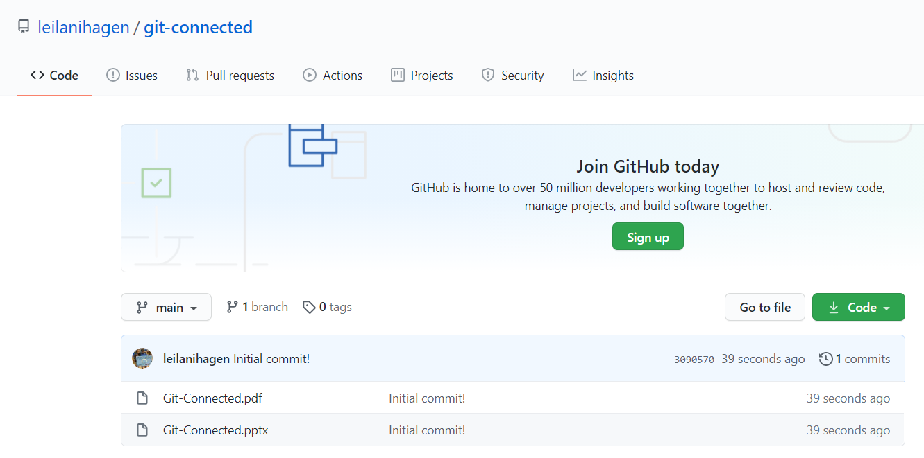
Get our slides!
2.
Notes:
Click on either the powerpoint (.pptx) or pdf (.pdf) version of our slideshow. The powerpoint version contains out speaker notes.

Slide 4
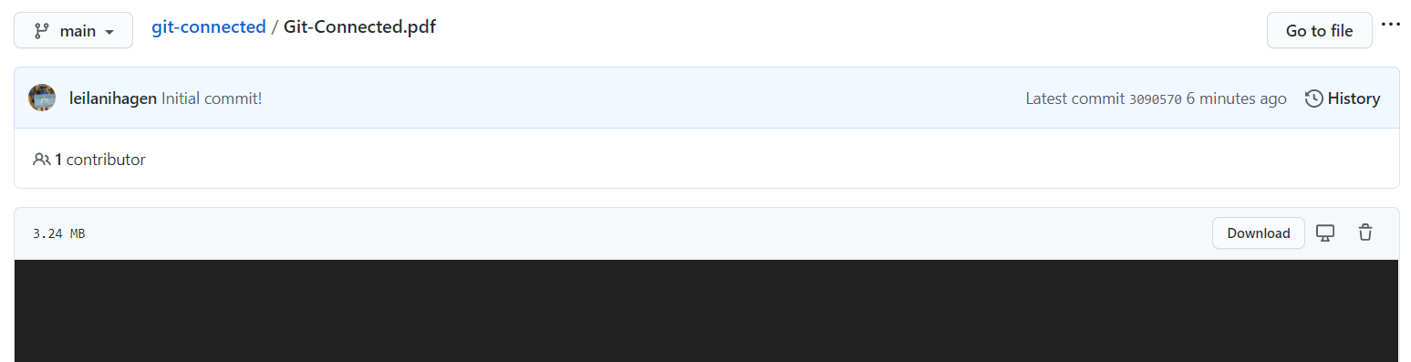
Get our slides!
3.
Notes:
Once you have clicked into the file, click download!

Slide 5

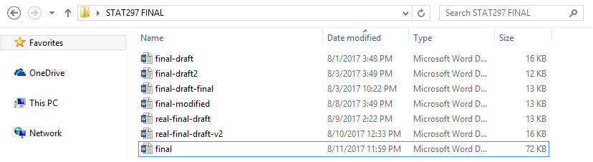
File management
Notes:
These days keeping track of your files is important. Especially since many of us are working and studying from home. The time spent searching for files could be used for more important things. Luckily there are great tools to handle this.

Slide 6

Git
Distributed
Fast
Secure
Offline
Notes:
Today we will introduce Git. Git was created in 2005 by Linus Torvalds, an American Finnish software engineer. He also created Linux, a popular operating system already used by many CS students at PSU. What does git stand for? It is actually british slang for “unpleasant person”.
Git is a free open source, distributed version control system. A version control system is software that records changes to files over time,
so that you can recall specific versions later.
Distributed means that multiple people can use git to collaborate on a project without being on the same network.
Git is fast. it is written in C, a low level language that requires little interpretation which means reduced runtimes.
Git is secure because it ensured the cryptographic integrity of every of literally every bit of your project.
Using a VCS generally allows you to not worry about messing things up. There are other version control systems out there, but git is more widely used. A feature that really makes Git stand apart is its branching model, which we will later talk about.
The files you manage through git does not always have to be code. For example: A cookbook, Dream journal, screenplay, or comic could be managed by git.
By the way it works offline!

Slide 7
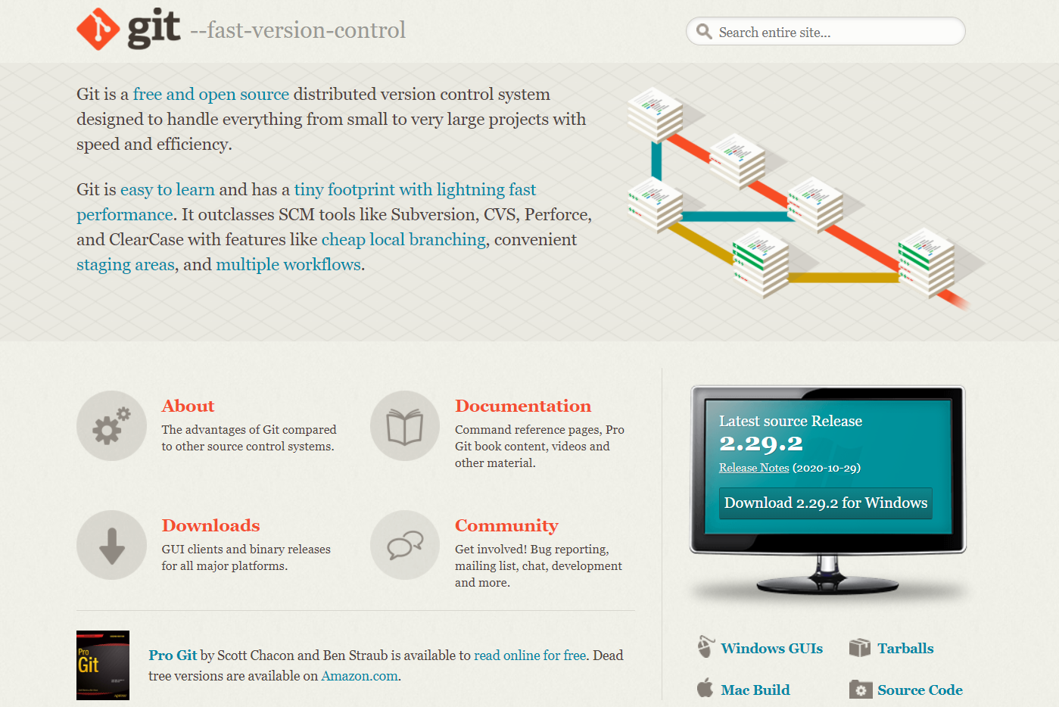
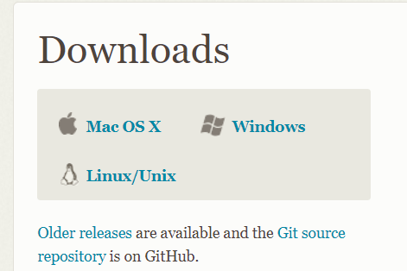
Installing git (Windows)
https://git-scm.com/downloads
Notes:
Git is free. To get it, search Git in the search bar or go to https://git-scm.com/downloads. There you will find the download link in the middle of the page. From there you will proceed to the download page asking for your operating system you are using. Since I am using windows, I will click Windows.
(download and install git)

Slide 8
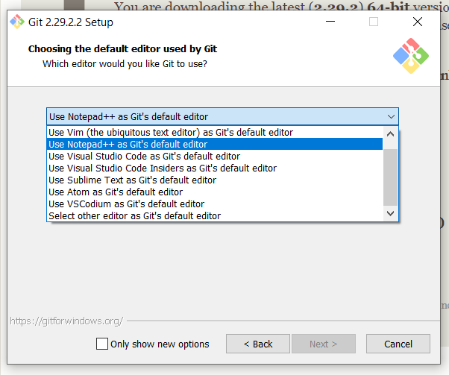
Installing git (Windows)
Notepad++ is much easier to use than Vim. In Vim you cannot use your mouse/cursor.
https://git-scm.com/downloads/win
Notes:
If you are comfortable with using Vim go ahead and keep clicking next after this. If not, I recommend selecting Notepad ++ as Git’s default text editor.

Slide 9
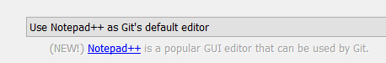

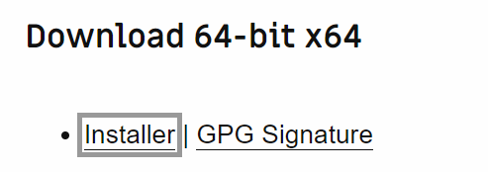
Installing git (Windows)
https://git-scm.com/downloads/win

Slide 10
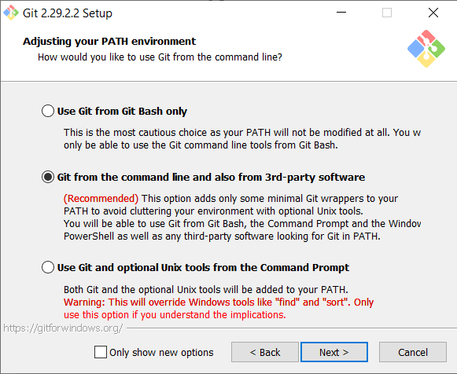
Installing git (Windows)
This option allows you to use git from git bash, Windows cmd, PowerShell and other places!
https://git-scm.com/downloads/win
Notes:
The option to use Git from the command line and also third party software should already be selected. If not, it is recommended to enable this option so we can use git on other command lines like windows cmd. And other terminal like programs

Slide 11

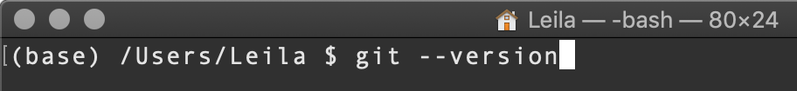
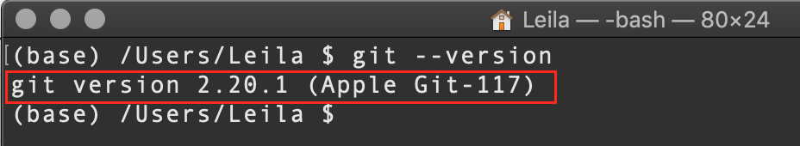
Installing Git - Mac OSX
If you have Xcode Command Line Tools on your mac, you already have git.
Type ‘git --version’ and press enter
If you see similar output, a git version number, then you already have git, and you can skip the next steps!
Notes:
If you are using a mac and have Xcode command line tools, you already have git. To confirm this, type “git --version” in your command line.
If you see a related output similar to the bottom picture you are all set! You can skip the next steps.

Slide 12
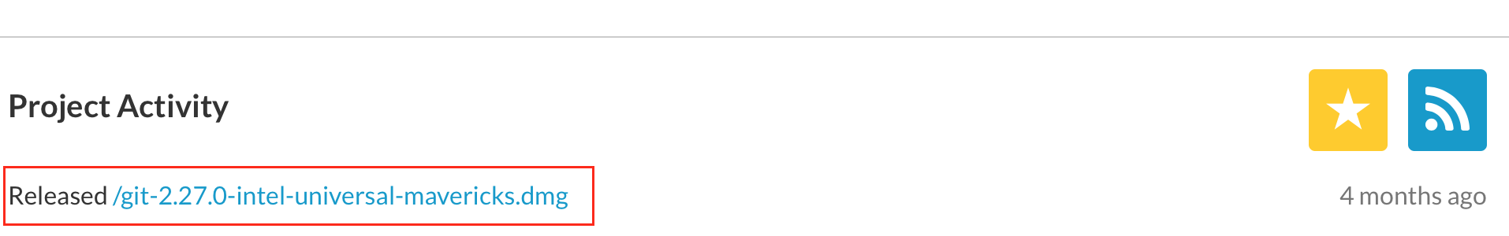
Installing Git - Mac OSX - Install a Disk Image
Navigate to: https://sourceforge.net/projects/git-osx-installer/
Click on the link to download the latest disk image file (it will be at the top of the list)
Notes:
Navigate to slide #10 and click on the link to go to the sourceforge installer
Going to sourceforge makes sure you get an installer
If you do not see a proper git version output on mac, we recommend searching git osx installer on our browser and downloading the most recent release of git.

Slide 13
Installing Git - Mac OSX - Check Installation
Check to make sure your install is successful with the following command:
Type ‘git --version’ and press enter
If you see similar output, congrats, you have git!
Issues setting your PATH? Get help here
Notes:
Verify your installation was successful

Slide 14
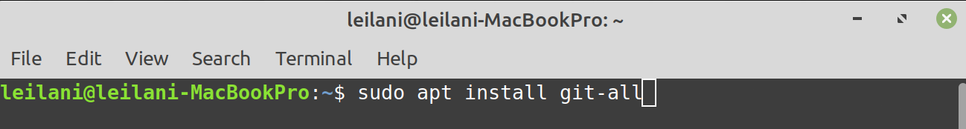
Installing Git - Linux - Debian-based distros
If you have a Debian based Linux distribution, use the following command:
Debian ditros:
Ubuntu, Linux Mint, MX Linux, Deepin Linux, Kali Linux, PureOS.
Type ‘sudo apt install git-all’ and press enter
Notes:
If you have a debian based Linux distribution, such as: Ubuntu, and Linux Mint, use the command “sudo apt install git-all” once this is finished type “git version” to verify the installation was successful.
Google your distro to see if it is Debian-based

Slide 15
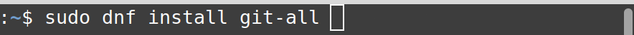
Installing Git - Linux - RPM-based distros
If you have an RPM-based Linux distribution, use the following command:
RPM distros: Fedora, RHEL, CentOS.
Type ‘sudo dnf install git-all’ and press enter
Notes:
For RPM based distributions like Fedora, type “sudo dnf install git-all” in your command line tool and press enter. Once again, type “git version” to verify.
Look up your distro to see if it is RPM-based.

Slide 16
Installing Git - Linux - Check Installation
Type ‘git --version’ and press enter
If you see a version number, your install was successful!
Notes:
If you have a debian based Linux distribution, such as: Ubuntu, and Linux Mint, use the command “sudo apt install git-all” once this is finished type “git version” to verify the installation was successful.
Google your distro to see if it is Debian-based

Slide 17
Git Bash First time set up
Git Bash
User Settings
Git config --global user-name <user-name>
Git config --global user-email <your-email>
Terminal commands
Mkdir <directory-name>
Initializing a Repository
Git init
Notes:
For this demonstration, I am going to use git bash, this was installed with git.
Open up git bash
Verify version of git using “git --version”
Set up username and email by typing: “git config --global user.name <username>/ git config --global user.email <email address>, this will make git save your identification across your changed file, the --global flag saves this information across your whole system for git.
Find a project folder
“mkdir <git_demo>”
“Cd <git_demo>”
Type “git init”
To show that this command created hidden files use “git init” use the command “ls -a”
You don’t need to worry about these hidden files, but we will give a brief rundown for what they do.

Slide 18
Initializing a Local Repository
Notes:
So what we did was create new directory, moved into said directory, and initialize the repository with “git init”. This directory will house everything related to the project.

Slide 19
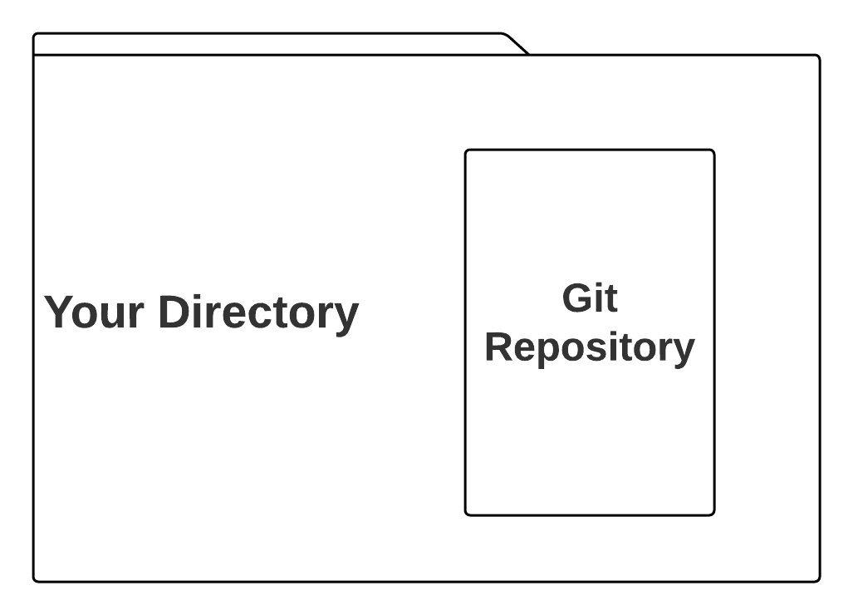
So… what is a repository, really? Directory?
Notes:
What is a repository?
What is a directory? A directory is a folder on your computer.
A repository is a container that lives in each directory that comes into existence when you type “git init”
We often speak of the repository as if it is the directory itself. We say a file is “in” a repository just like files and directories are “in” directories. This is a good way to think of a repository. It’s kind of like a little container inside the directory that serves git’s copy of the directory, with copies of all the files that git can see and manage. This is why, if you accidentally delete a file, git can restore it for you, because git keeps a hidden copy in the repository.
Any questions?

Slide 20
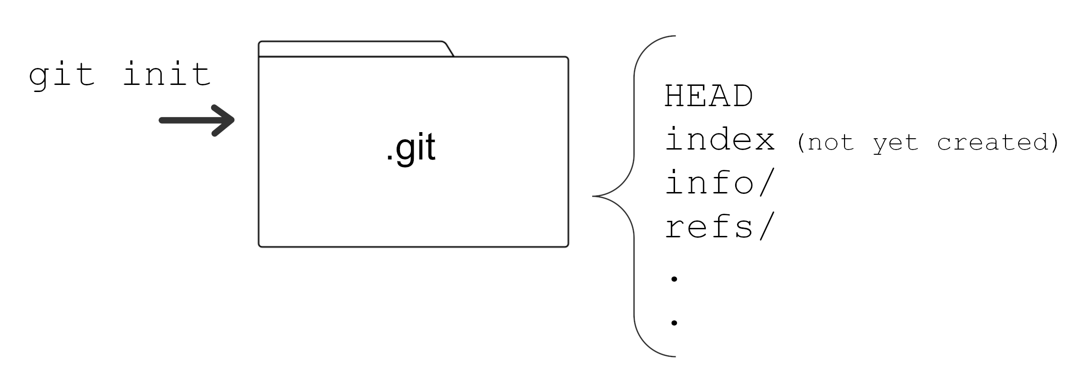
What makes the repository?
When you run git init, git creates the repository which is a hidden folder in your working directory. This folder contains important files and folders that Git uses to operate.
Notes:
The hidden .git file holds important information necessary for your project in version control and all the information about commits, remote repository address, etc. All of them are present in this folder. It also contains a log that stores file history.

Slide 21
creating & editing files through Git bash
Creating Files
touch <filename>
Editing Files From command line
start <filename>
Notes:
Ok now I am going to create some files for my project. The first file will be a hello world world project, the second will be a list of things I would want to do this Winter.
In git bash type “touch hello-world.txt” and “touch winter-list.txt”
Touch tells the command line that you want to make a file, the second argument is the name of that file with its type, in this case it is a text file so we add a .txt at the end.
Now we are going to edit the hello world file, to open a file from the bash command prompt, type “start <file-name>” this will open the file with your systems default program.
We can open and edit the file the normal way, but let's do it through bash.
Type “start hello-world.txt” to open it in your default editor for .txt files, for me it is notepad.
If you are using mac, you may have to use the command open -a TextEdit <filename>
Type Hello World! In the text editor. And save (ctrl + s, or file header menu).
Add something to the hello world file….like hello world!
Let's do the same to our to-do list.
I will add some things that I would like to do this winter.

Slide 22
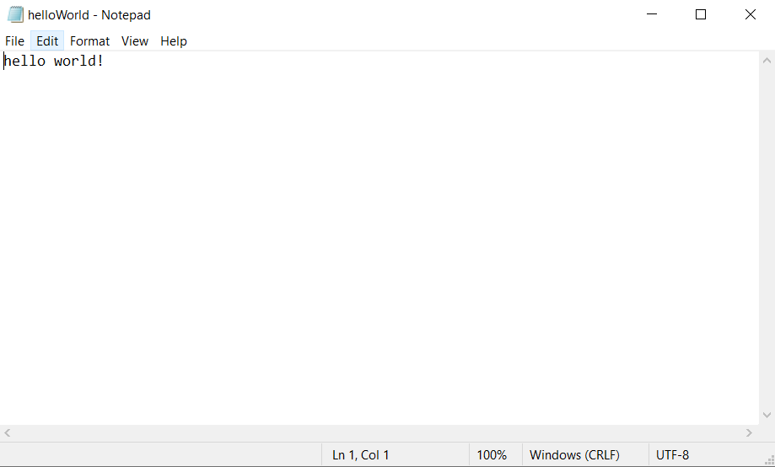
Notes:
This is what I see when I use the command start to open the hello-world text document. You may have notepad ++ instead of notepad if you chose to set it as your default text editor.

Slide 23
Staging Files
Git Status
Git Add
git add <filename>
git add .
Notes:
Ok now I am going to create a file for our project.
Type “git status” to see the status of the files we created in this directory. What we see is that these two files are currently red, and under untracked. This means that git is currently NOT keeping track of the history of these files.
To change this, type “git add <file_name>. You can add files individually, or if you want to add everything in the directory you can type “git add .”. Adding a dot after will tell the terminal to add all the files in the current directory.
Now confirm the files states have changed by typing “git status” again.
We will see that the files are green and now under changes to be committed. A commit is a snapshot of a repository. We will talk about this soon.

Slide 24
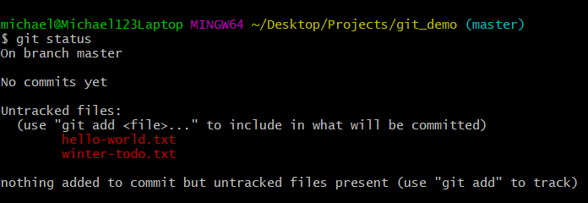
Type ‘git status’ and press enter
Notes:
This is what you should see after creating the two files and typing “git status”.

Slide 25
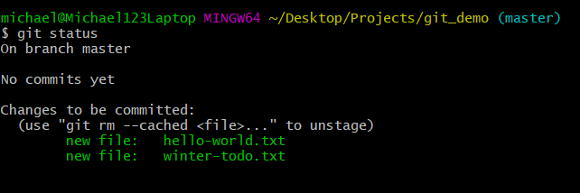
Notes:
After the “git add” command, we can see that the files are now staged by git and ready for commit.

Slide 26
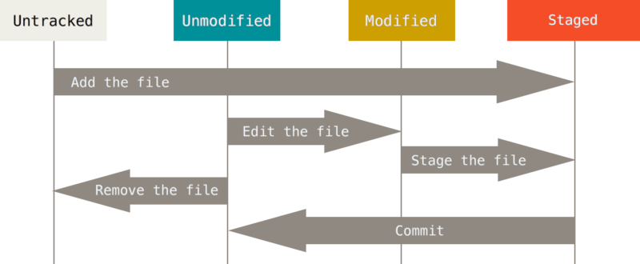
File Staging
The lifecycle of your files in a git repository will follow this flow.
Tracked = included in the repository’s previous commits
Staged = added to the current index, ready to be committed in the next commit
Src: git-scm book chapter 2.2
Notes:
Here is a very helpful general graph of the file states in a git repository. It looks complicated but after some time it will make sense.
A newly created file will always start as an “Untracked file”. Using the git add command we modified the untracked files to now be staged.
It is up to you to tell git what files should be staged.
When a file is “staged” it gets placed in the staging area, which is basically the storage area for all the files that have been changed that you want to be included in the next commit.
In the next step we will commit the files.

Slide 27
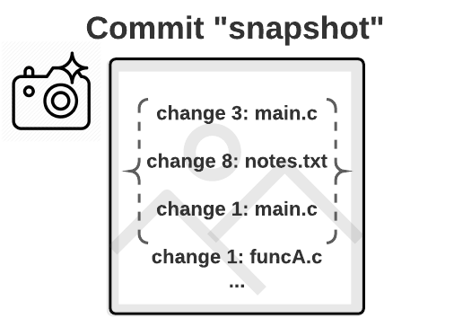
What is a commit?
Notes:
A commit is a snapshot of a state of your project!
The commit has a change ID, and it is the state of all the files contained in the commit at a point in time.
You add files to the snapshot by staging with the ‘add’ command like we did above, and once you’ve collected enough changed files and staged them, you are ready to commit your
Every time you make a commit, you want that commit to represent a state in that project that was important, like when you finished your first draft of the introduction in your essay, and a reference list that goes with it in another file. Done with intro!”
The add command would let you add both of these files that needs to be in the snapshot, and then commit would finalize and save the snapshot
Any questions?

Slide 28
Committing
Prepare a payload for pushing any changes into remote repository. The commit contains logs file (what have you changed in your code, files).
Command:
$ git commit -m “[your message go here]”
Note that every commit require message, -m stand for message.
Notes:
Ok, now it looks like we are ready to commit our files. git commit creates a commit, which is like a snapshot of your repository. These commits are snapshots of your entire repository at specific times.
Committing is one of the most important commands in git. Committing adds the files that were staged to git’s history. Git saves committed files using an SHA hash algorithm, meaning it compresses the files so they are smaller and easier to maintain.
You should make new commits often, based around logical units of change. This can be like first thing that comes to mind when your mom says “what did you today”. But in this case you talk about the changes you made to your files.
With the files in the staging area, type “git commit -m”initial commit”. The command “git commit” tells git you want to commit these files, “-m” is a flag for creating a message. “Initial commit” is a common first commit message, it makes it easier to find it later.
If everything went well you should see a message telling you how many files were changed, the number of lines added/removed, and the name of the files.

Slide 29
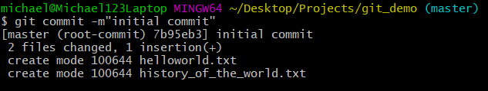

Slide 30
File Tracking and Staging
The lifecycle of your files in a git repository will follow this flow.
Tracked = included in the repository’s previous commits
Staged = added to the current index, ready to be committed in the next commit
Src: git-scm book chapter 2.2
Notes:
Looking back at the Life Cycle graphic, we can see that after committing our files we have now made them unmodified. You can verify this by checking “git status” and seeing that there is nothing to be committed anymore.
Once a file has been committed it will continue its life within the Unmodified, Modified, and Staged life cycle.
All files in the “Unmodified” state are tracked. This can be confusing, but it just means that they were included in the last commit, and git now considers them unchanged since the last commit.

Slide 31


Notes:
In each story there are going to me main characters, secondary characters, and others. Each character plays a significant role in the story but some may not need much attention.
Much like directors of committing repositories, we manage the roles of the files, main characters are going to be the files that are often changed, and other characters not so much.

Slide 32
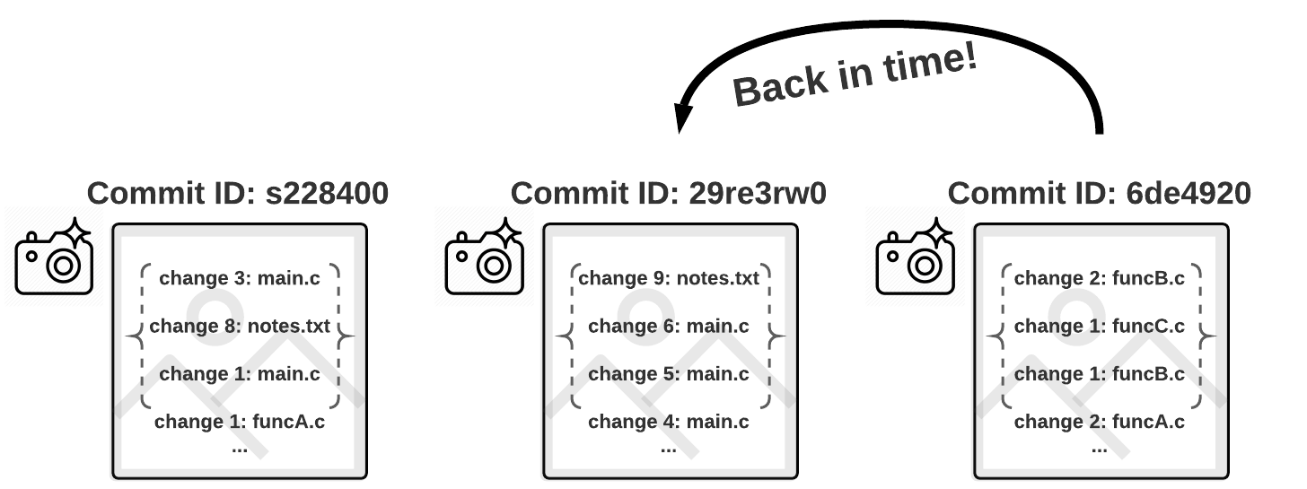
Undoing Things!
No universal “undo” command
Go back in time!
Notes:
Because of git’s structure, git doesn’t have a traditional “undo” command. But you can undo things, and it usually amounts to a “going back in time” to a previous state of your project.

Slide 33
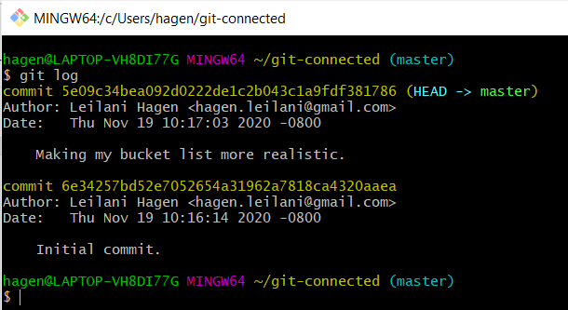
Undoing Things! - Git Log
We can use the git log command to view the git log - a saved list of recent commits made in your repository.
Notes:
The purple highlights here is the commit IDs. Each commit has an ID so that they can be told apart
The most recent commit is actually at the top

Slide 34
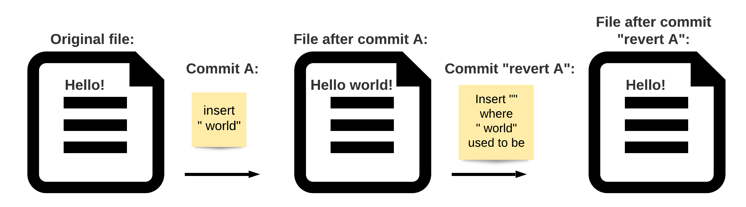
Undoing Things! - Revert
Simplest and safest - commits the inverse of the commit you are reverting.
To revert a commit, type ‘git revert <change-ID>’ and press enter
Read more about “undoing”: https://www.atlassian.com/git/tutorials/undoing-changes
Notes:
Checking out previous commits.
(Take the changeID from the previous slide and revert it)
Git revert is the simplest and safest way to “undo” a commit. It simply commits the inverse of the commit you are “undoing,” and by doing this you still add this action of “undoing” the last commit to your history. This way, everything gets documented, and if you want to undo the undo, you can do that easily by just undoing the new most recent commit!
To do a git revert
Type git revert <commit ID>

Slide 35
Undoing Things! - Revert
To perform git revert:
Copy the first 8 digits of the Commit ID from git log
Type ‘git revert <commit ID>’
Enter your revert commit message or accept the default
To revert a commit, type ‘git revert <change-ID>’ and press enter
Read more about “undoing”: https://www.atlassian.com/git/tutorials/undoing-changes
Notes:
Checking out previous commits.
(Take the changeID from the previous slide and revert it)
Git revert is the simplest and safest way to “undo” a commit. It simply commits the inverse of the commit you are “undoing,” and by doing this you still add this action of “undoing” the last commit to your history. This way, everything gets documented, and if you want to undo the undo, you can do that easily by just undoing the new most recent commit!
To do a git revert
Type git revert <commit ID>

Slide 36
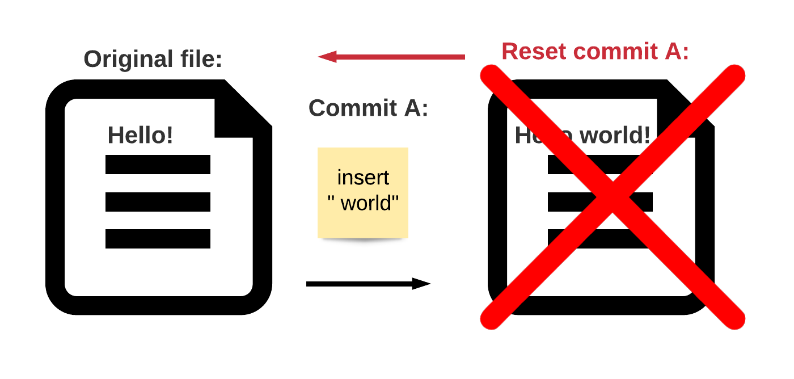
Undoing Things! - Reset
Reset simply wipes gits history of a commit, making it as if the commit never happened and returning to the earlier commit
To revert a commit, type ‘git revert <change-ID>’ and press enter
Read more about “undoing”: https://www.atlassian.com/git/tutorials/undoing-changes
Notes:
There is another git command for “undoing” commits called reset, and it is commonly used, but it is a little bit riskier, because git reset simply deletes the last commit without saving any history about it. It makes it as if the commit never happened. This can be useful in some situations but it can also cause problems if not used correctly, so we recommend you stick to git revert for now
Any questions?

Slide 37
Accidentally Committed too Early?
Just amend! Amend lets you add more staged changes to a previous commit
To amend to your last commit, type ‘git commit --amend’
and press enter
Notes:
Did you think you were done with a new feature of your app and ready to commit your changes, but realized you forgot an edge-case somewhere? You can simply make the new changes, stage them with the add command, and then use git commit amend to add the changes to the previous commit! No need to revert, just simply add them retroactively.

Slide 38
When Should I Commit? How Often? WHY?!
How often?
Every time you reach a point in your project that you want to be able to go back to
More frequent commits is best
Why?!
It saves your place in your project
Documents the work in your project! Without you even thinking about it =)
Notes:
Leilani (put this slide at the end of the “Undoing Things!” sildes)
You should commit whenever you are at a place in your project that you want to remember. If you’re coding, and you’ve gotten one of your functions to work, but another one is still broken, commit! That way if that first function somehow breaks later, you can go back and see how it was working before.

Slide 39

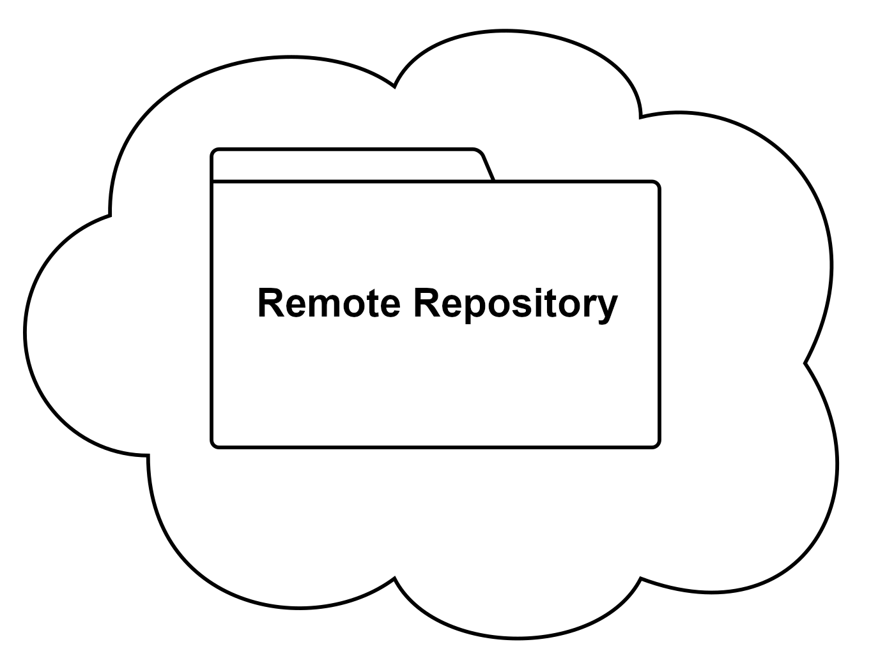
Remote Repositories
Remote repositories are git repositories, just like the one we’ve just created, that live on the cloud somewhere.
Notes:
Tuan
Remote repositories are usually just one copy of a project that is stored in the cloud. There is usually at least one other copy that you store on your own computer, or multiple copies if it is a collaborative project.

Slide 40
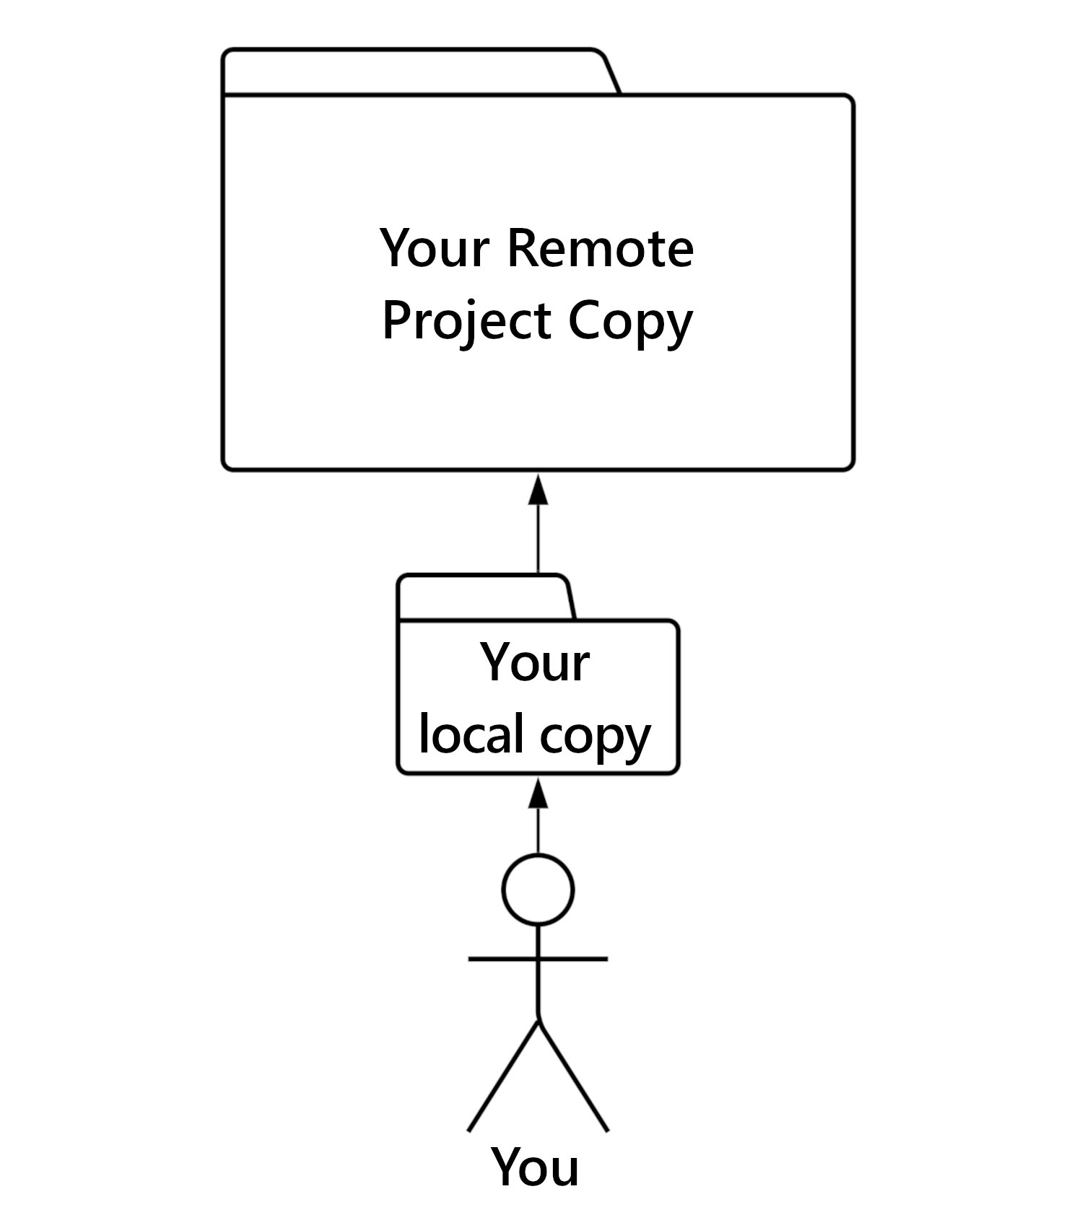
Remote Repositories -
Individual
Remote repositories can be used as a way to back-up and version control your own files, without collaboration.
Notes:
Tuan
What are remote repositories good for?
Might make the arrows to remote dotted to signify cloud storage

Slide 41
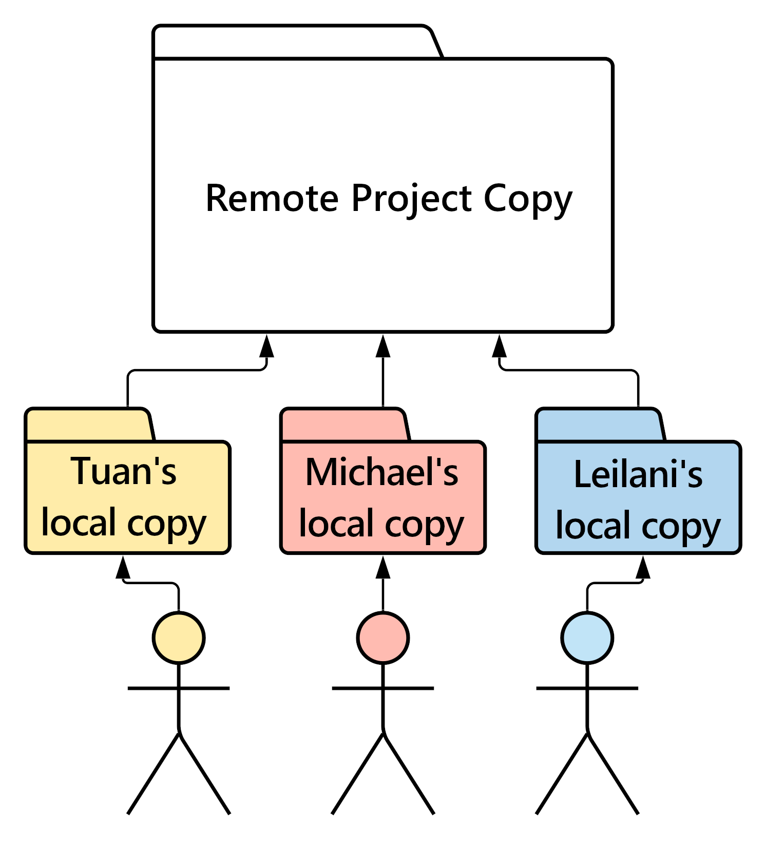
Remote Repositories -
Collaboration
Remote repositories are often used as the central point of collaboration between team members or classmates.
Notes:
Tuan
Collaborative remote structure (this is where it gets interesting): In this setup, each member will have a varying level of access to the remote project copy, and will typically work by making changes to their own copy before finalizing the changes and adding them to the remote repository.
Might make the arrows to remote dotted to signify cloud storage

Slide 42
SSH Access
In order work with remote repositories, we need to configure a public SSH key.
SSH = Secure Shell network protocol. In short, it lets your computer securely transfer files to your Git remote repository over an unsecured open network. SSH accomplishes this by using a pair of keys, one public key and one private key.
Open git bash
Command: $ ssh-keygen
Src (read more about SSH keys): https://www.atlassian.com/git/tutorials/git-ssh
Notes:
A key for github to recognize your machine. It’s the only way to allow your machine connect to your git account and modify your project. Without key, the only thing you can do is cloning.

Slide 43
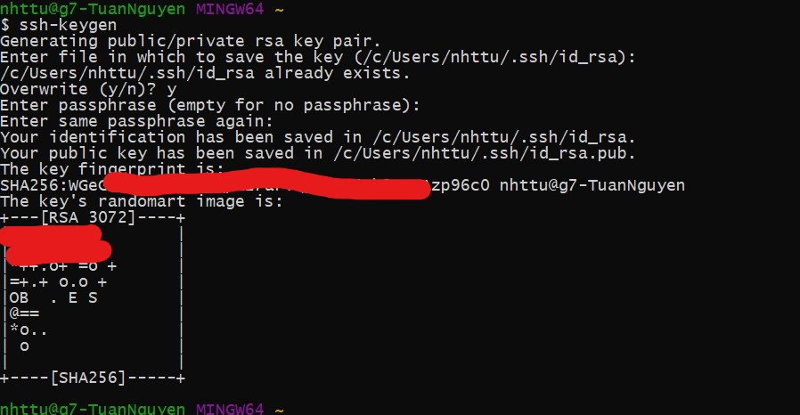

Slide 44
Creating Your Remote Repository
Once you have configured your SSH keys, you can create a remote and add it to your local repository’s list of remotes. You can then use the remote repo to back up your local repository that you just created.
Notes:
Tuan

Slide 45
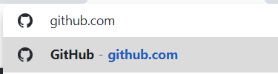
Creating Your Remote Repository
Navigate to GitHub.com and sign in or create an account.
Notes:
What are remote repositories good for?

Slide 46
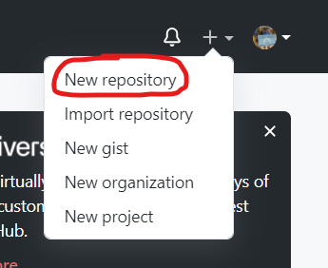
Creating Your Remote Repository
Once you are signed in, find the ‘+’ icon in the top right corner, click and choose ‘New repository’
Notes:
What are remote repositories good for?

Slide 47
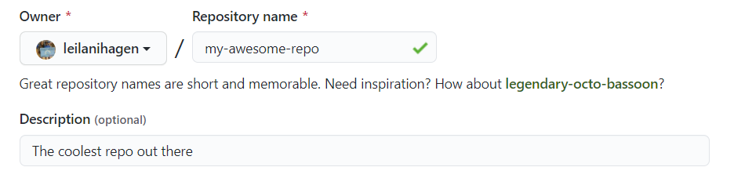
Creating Your Remote Repository - Name
Choose a name (NO SPACES, dashes are common convention), and add a description if you like.
Notes:
What are remote repositories good for?

Slide 48
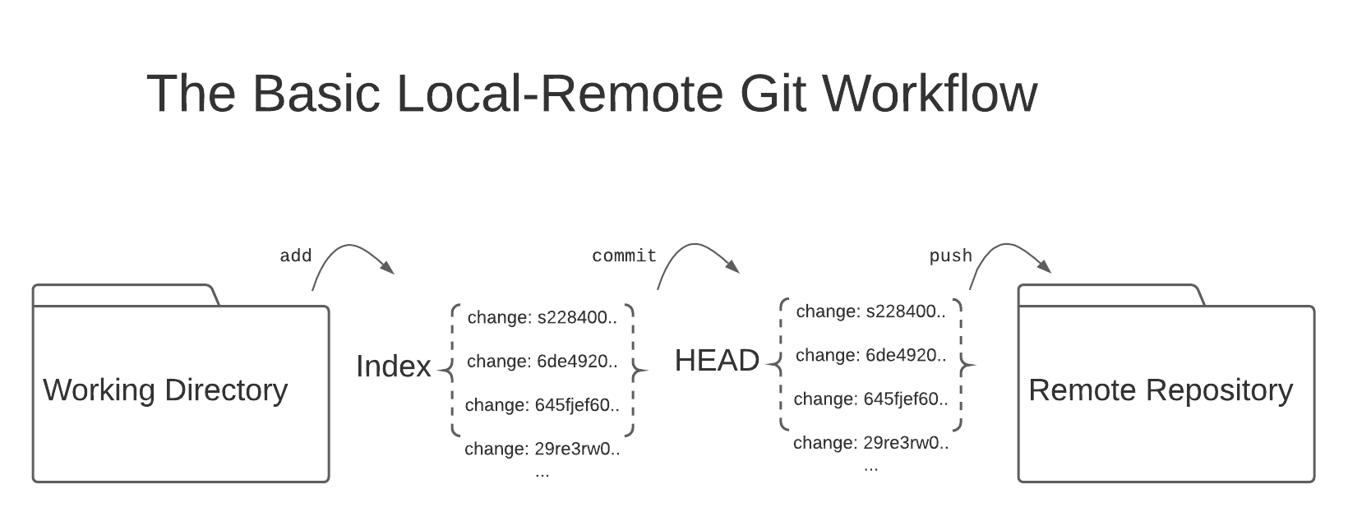
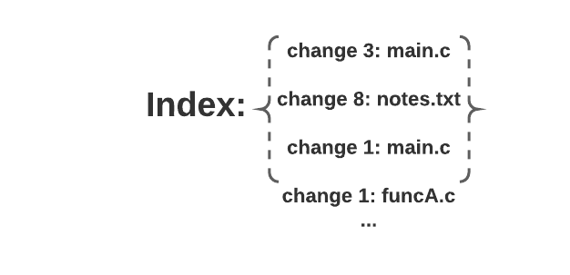
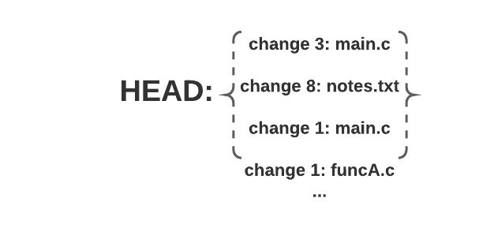
Local-Remote Workflow
git add
git commit
git push

Slide 49
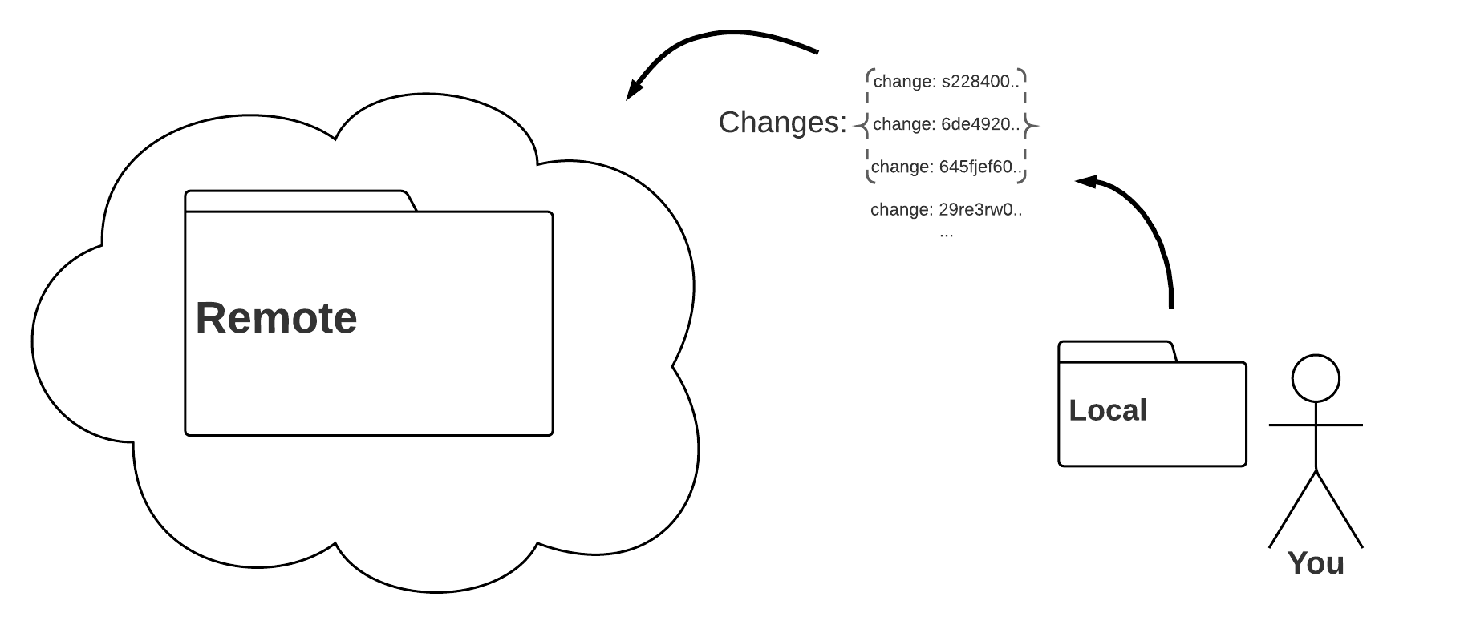
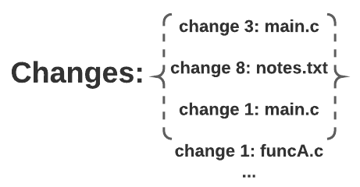
Pushing Changes to a Remote Repository
Pushing is how you transfer a commit (group of tracked changes) from your local repository to your remote repository.
‘git push <remote>’

Slide 50
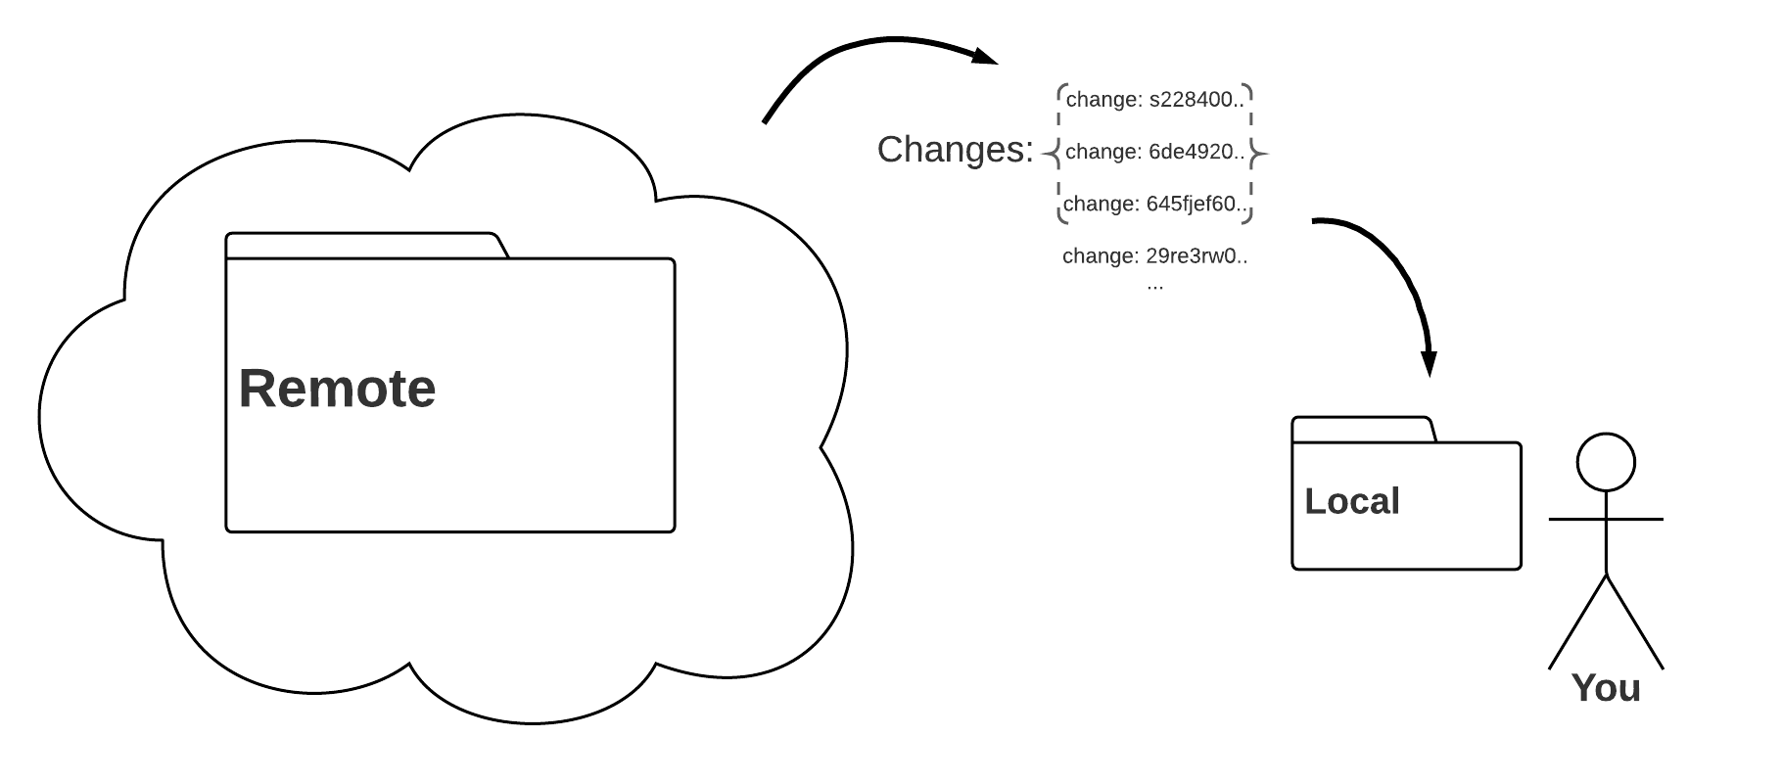
Pulling Changes from a Remote Repository
Pulling is how you update your local repository to be up-to-date with the current state of the remote repository.
‘git pull <remote>’
Notes:
Think of it as “pulling down” or “copying” the changes from your remote into your local repository.
Pulling is very important for collaboration, because it lets you download the changes that your teammate made to the remote repo.

Slide 51
Q&A - No Tough Questions!
(Here’s a Git cheat sheet to remember all of today’s commands, plus more!): https://training.github.com/downloads/github-git-cheat-sheet/
Notes:
Remeber, we’re still learning too, so no tough questions!

